Slide 1

The QUIC Transport Protocol
- Design and Internet-Scale Deployment
Chen, Zixuan

Slide 2

OUTLINE
0

Slide 3
Outline
1
INTRODUCTION
2
WHY QUIC
Introduction to QUIC
Why do we use QUIC. What problems can QUIC solve on existing networks?
3
DESIGN & IMPLEMENTATION
4
EXPERIMENTS & EXPERIENCES
Detailed design principles and reasons for QUIC
Experiments in the production environment to deploy QUIC and experiences

Slide 4
INTRODUCTION
1

Slide 5
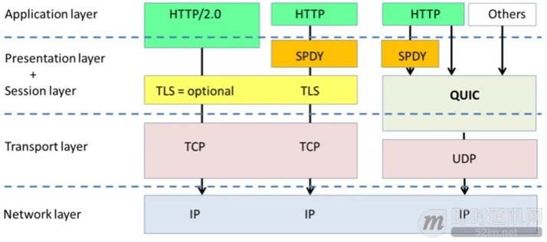
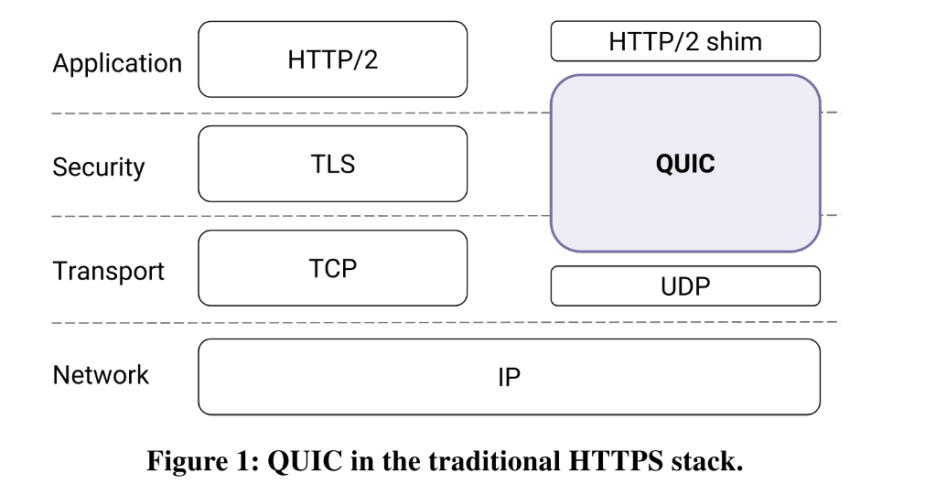
WHAT’s QUIC
QUIC (Quick Udp Internet Connection)
A new transport designed from the ground up to improve performance for HTTPS traffic and to enable rapid deployment and continued evolution of transport mechanisms.
QUIC replaces most of the traditional HTTPS stack: HTTP/2, TLS, and TCP (Figure 1).
QUIC is developed as a user-space transport with UDP as a substrate.

Slide 6
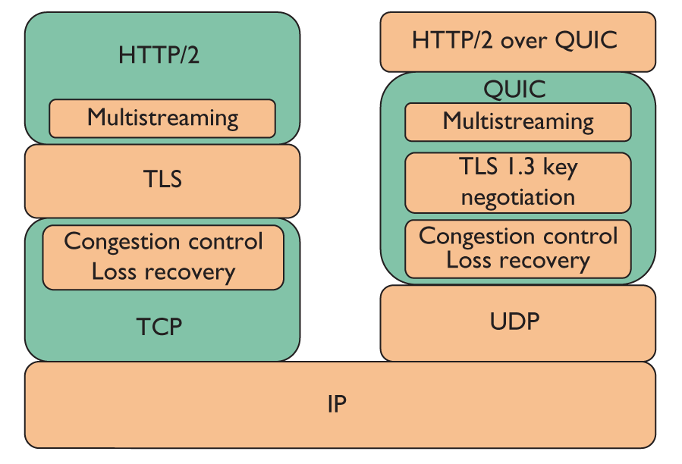
WHAT’s QUIC
QUIC (Quick Udp Internet Connection)
A new transport designed from the ground up to improve performance for HTTPS traffic and to enable rapid deployment and continued evolution of transport mechanisms.
QUIC replaces most of the traditional HTTPS stack: HTTP/2, TLS, and TCP (Figure 1).
QUIC is developed as a user-space transport with UDP as a substrate.
本站开始支持 QUIC
https://halfrost.com/quic_start/
Notes:
QUIC 在 UDP 之上，如果想要和 TCP/IP 体系类比，那么就是上图。QUIC 可以类比 TCP/IP 中的 TLS 一层。但是功能又不完全是 TLS ，还有一部分 HTTP/2 ，下面还包括一部分 TCP 的功能，比如 拥塞控制、丢包恢复、流量控制等特性。

Slide 7
The Road to Deployment
QUIC has been globally deployed at Google on thousands of servers and is used to serve traffic to a range of clients including a widely-used web browser (Chrome) and a popular mobile video streaming app (YouTube).
On the server-side, our experience comes from deploying QUIC at Google’s front-end servers, which collectively handle billions of requests a day from web browsers and mobile apps across a wide range of services.
On the client side, we have deployed QUIC in Chrome, in our mobile video streaming YouTube app, and in the Google Search app on Android. We find that on average, QUIC reduces latency of Google Search responses by 8.0% for desktop users and by 3.6% for mobile users, and reduces rebuffer rates of YouTube playbacks by 18.0% for desktop users and 15.3% for mobile users.

Slide 8
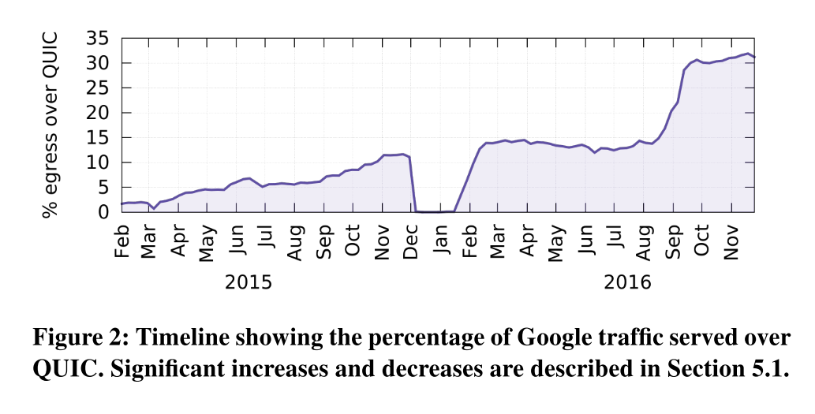
The Road to Deployment
As shown in Figure 2, QUIC is widely deployed: it currently accounts for over 30% of Google’s total egress traffic in bytes and consequently an estimated 7% of global Internet traffic [61].
Notes:
中间的突然消失：发现bug
后面的上升：YouTube，包括Mobile YouTube

Slide 9
WHY QUIC
2

Slide 10
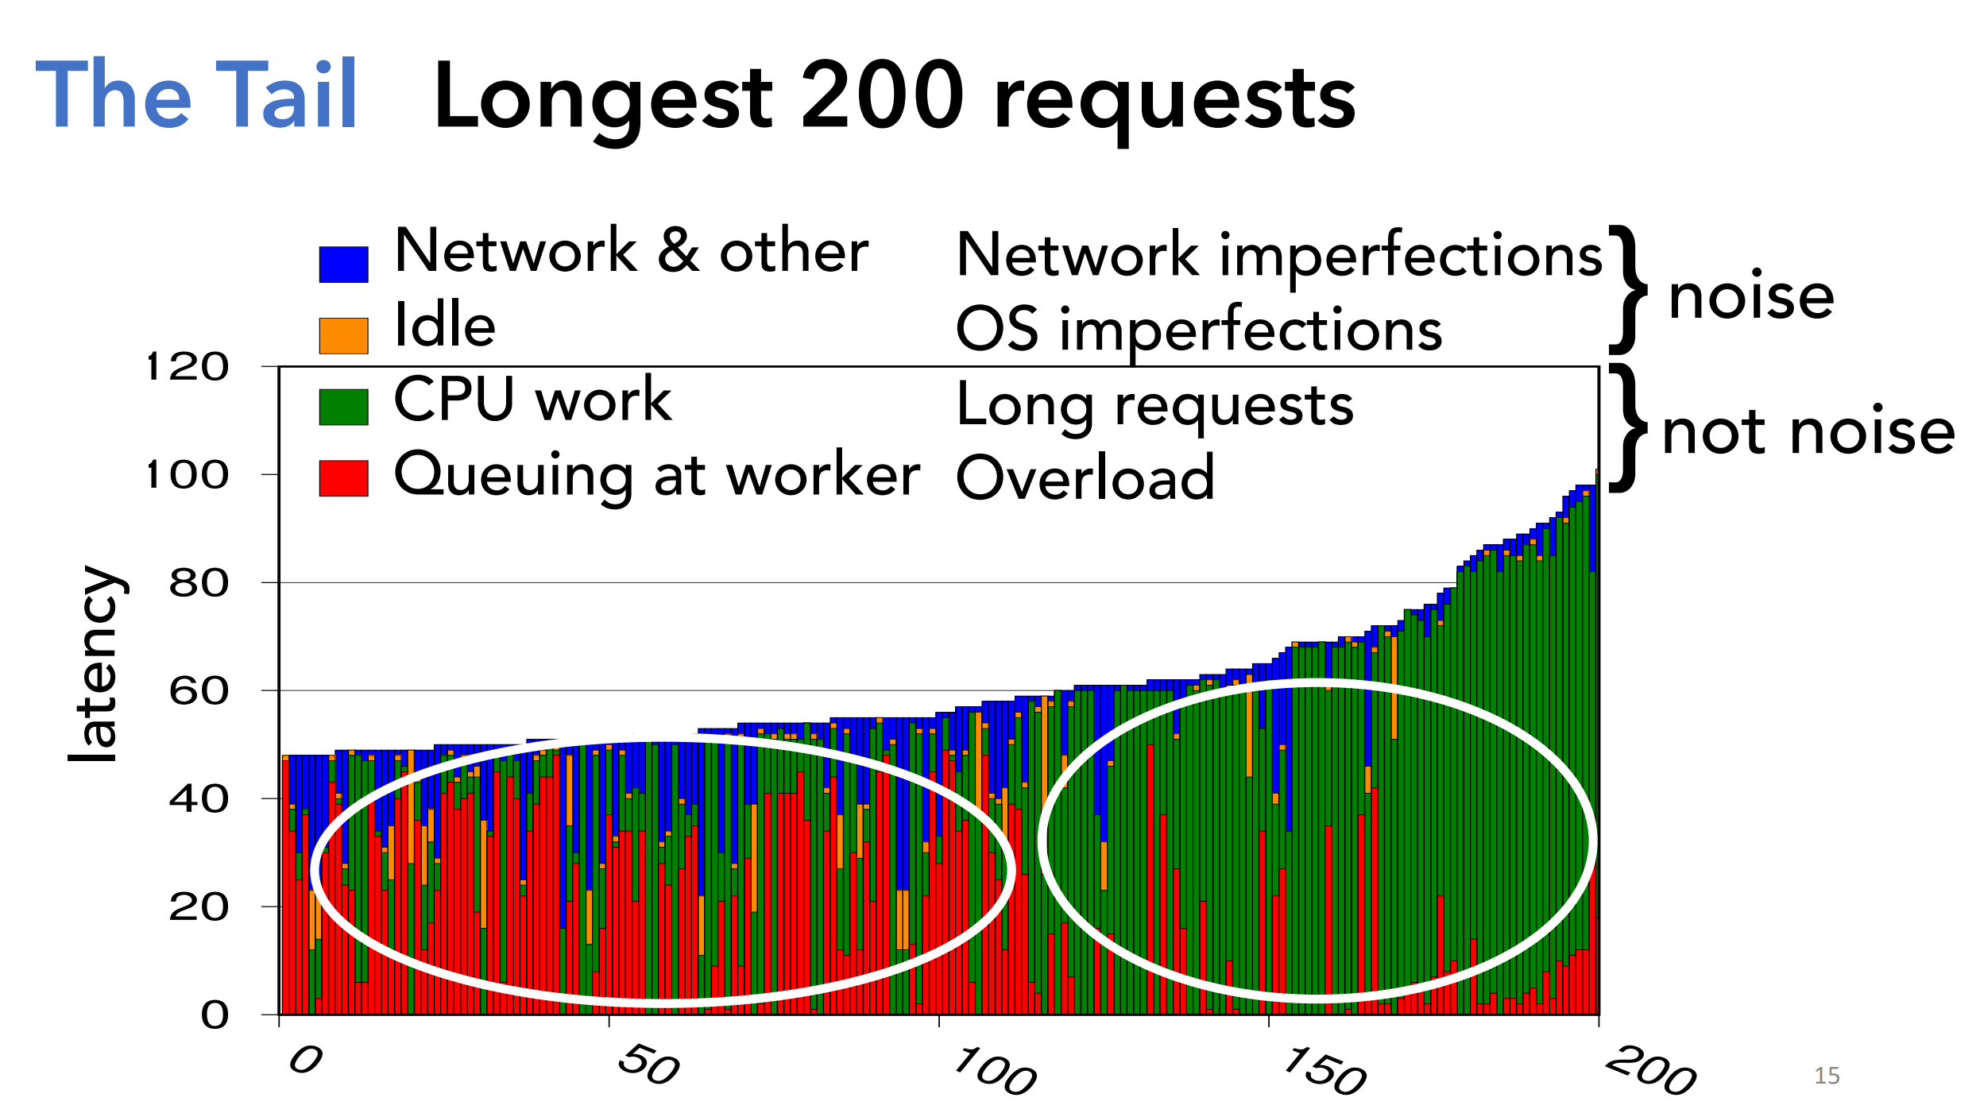
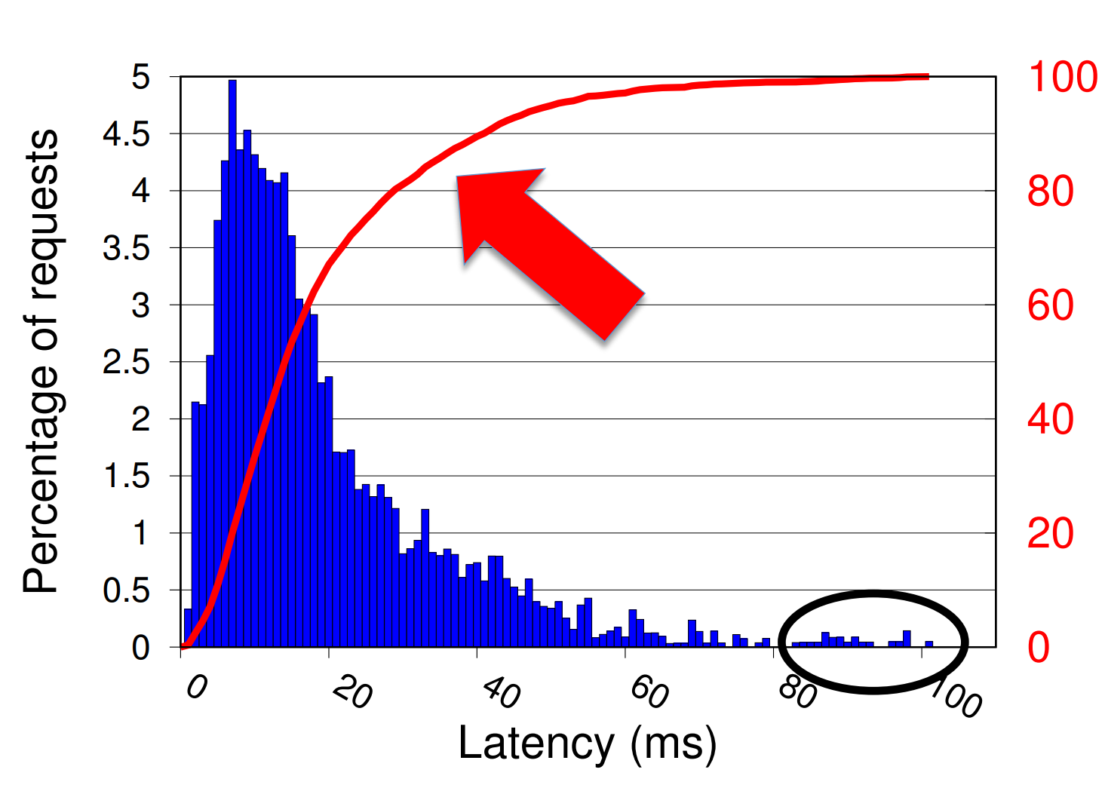
MOTIVATION: WHY QUIC
Growth in latency-sensitive web services and use of the web as a platform for applications is placing unprecedented demands on reducing web latency.
Web latency remains an impediment to improving user experience, and tail latency remains a hurdle to scaling the web platform.
Tail Latency
Measuring and Optimizing Tail Latency, Kathryn S McKinley, Google
https://cra.org/cra-wp/wp-content/uploads/sites/8/2018/04/VUTH-14-combined-slides.compressed.pdf
Notes:
Google: 400 millisecond delay decreased searches/user by 0.59%.
Bing: Two second slowdown reduced revenue/user by 4.3%.

Slide 11
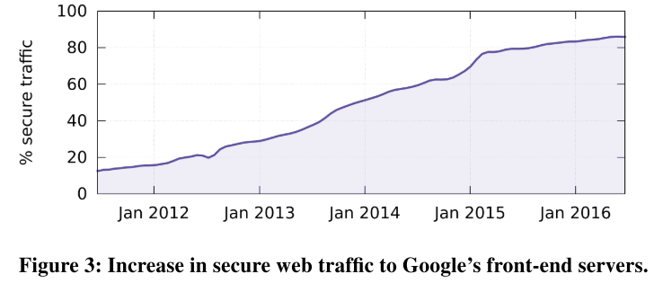
MOTIVATION: WHY QUIC
At the same time, the Internet is rapidly shifting from insecure to secure traffic, which adds delays.
Efforts to reduce latency in the underlying transport mechanisms commonly run into the following fundamental limitations of the TLS/TCP ecosystem.
Notes:
As an example of a general trend, Figure 3 shows how secure web traffic to Google has increased dramatically over a short period of time as services have embraced HTTPS.

Slide 12
MOTIVATION: WHY QUIC
Shortcomings of TCP
Protocol Entrenchment
Implementation Entrenchment
Handshake Delay
Head-of-line Blocking Delay

Slide 13
Protocol Entrenchment
Middleboxes have accidentally become key control points in the Internet’s architecture.
Firewalls tend to block anything unfamiliar for security reasons and Network Address Translators (NATs) rewrite the transport header, making both incapable of allowing traffic from new transports without adding explicit support for them.
Any packet content not protected by end-to-end security.
Modifying TCP remains challenging due to its ossification by middleboxes.
Deploying changes to TCP has reached a point of diminishing returns, where simple protocol changes are now expected to take upwards of a decade to see significant deployment.

Slide 14
Implementation Entrenchment
TCP is commonly implemented in the Operating System (OS) kernel. As a result, even if TCP modifications were deployable, pushing changes to TCP stacks typically requires OS upgrades. This coupling of the transport implementation to the OS limits deployment velocity of TCP changes; OS upgrades have system-wide impact and the upgrade pipelines and mechanisms are appropriately cautious [28].
OS upgrades at servers tend to be faster by an order of magnitude but can still take many months because of appropriately rigorous stability and performance testing of the entire OS.
This limits the deployment and iteration velocity of even simple networking changes.
Notes:
PC，服务器电脑，系统升级缓慢的问题
举例说明 TCP部署新协议

Slide 15
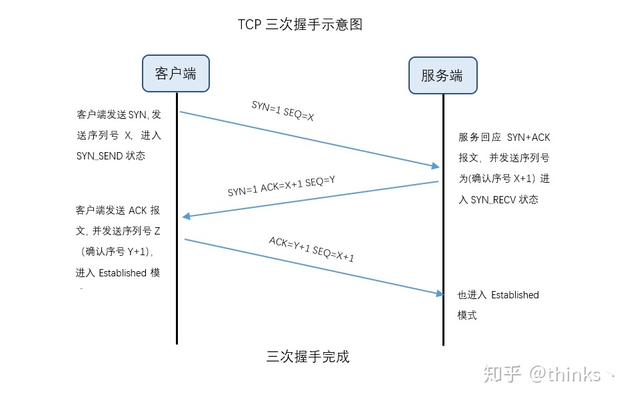
Handshake Delay
TCP connections commonly incur at least one round-trip delay of connection setup time before any application data can be sent, and TLS adds two round trips to this delay.
《TCP三次握手，四次挥手》
https://zhuanlan.zhihu.com/p/76874892
Notes:
连接终止
quic 在保持空闲到约定的时间之前都应该保持打开状态， 当 server 端决定终止一个空闲的连接的时候， server 端因该避免通知client端。 一个 connection 建立成功之后有以下两种方式被关闭
主动关闭 一个 endpoint 可以发送一个 CONNECTION_CLOSE 帧给同伴，说明开始关闭 connection， endpoint 也可以发送更高优先级的 GOAWAY 帧来表示连接将要被关闭。
被动关闭 一个 QUIC connection 的默认空闲超时是 30 s， 最大超时时长是 10 m，如果在 空闲超时的时间内没有网络活动，连接将会被关闭，一个默认的 CONNECTION_CLOSE 将会被发送
上述内容用于与四次挥手比较

Slide 16
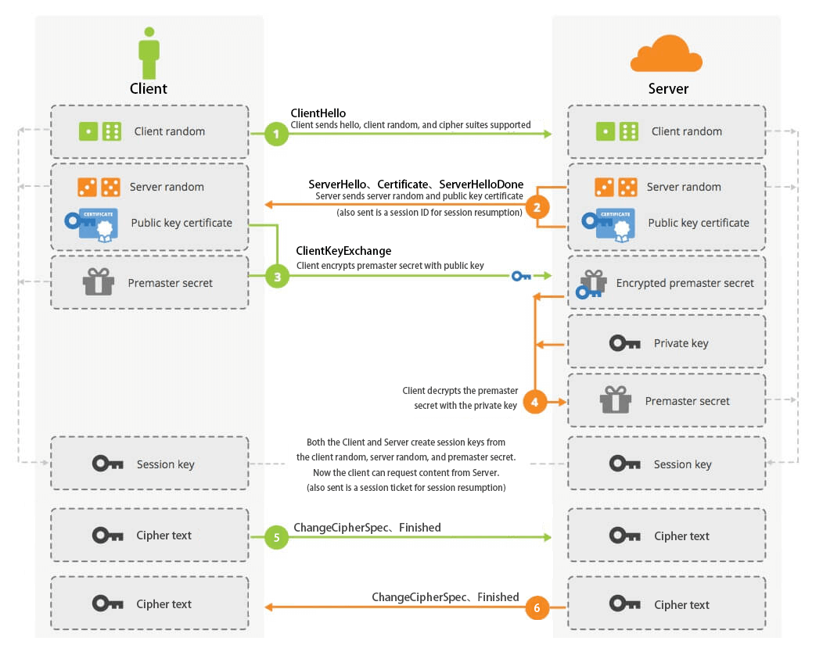
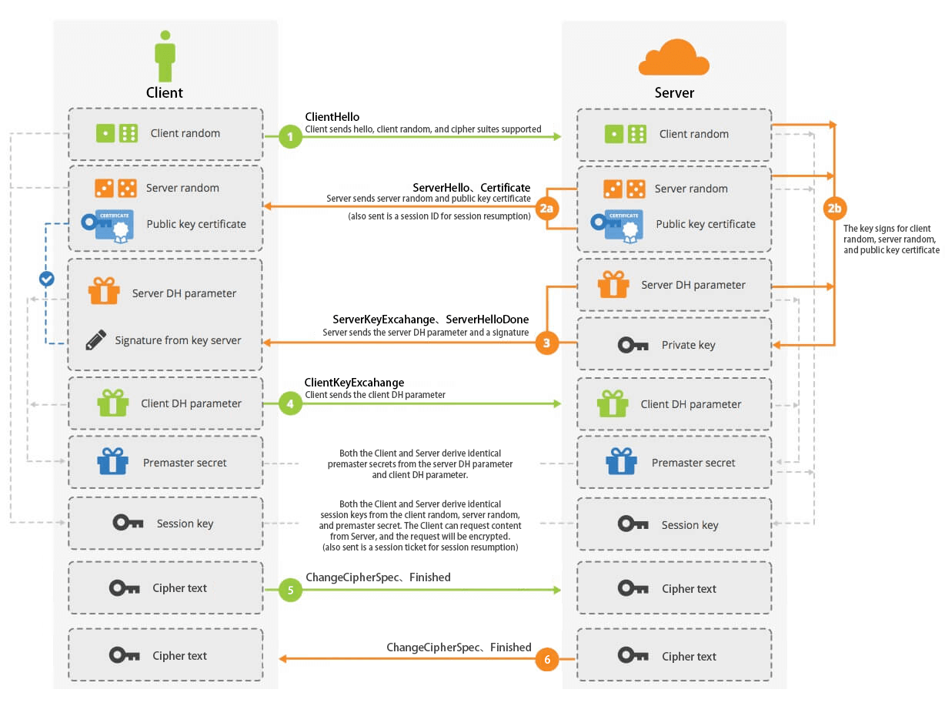
Handshake Delay
TLS Handshake RSA
TLS Handshake Diffie-Hellman
HTTPS 温故知新（三） —— 直观感受 TLS 握手流程(上)
https://halfrost.com/https_tls1-2_handshake/

Slide 17
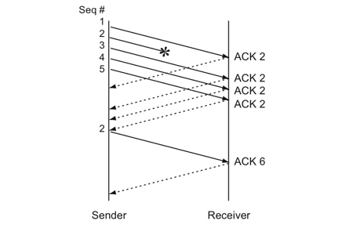
Head-of-line Blocking Delay
TCP’s bytestream abstraction, however, prevents applications from controlling the framing of their communications [12] and imposes a "latency tax" on application frames whose delivery must wait for retransmissions of previously lost TCP segments.
Sample of Fast Retransmit
浅谈TCP（1）：状态机与重传机制
https://monkeysayhi.github.io/2018/03/07/浅谈TCP（1）：状态机与重传机制/
Notes:
HTTP/2 多路复用，重传等待带来的影响将会更严重

Slide 18
QUIC’s Goal
QUIC is designed to meet several goals [59], including deployability, security, and reduction in handshake and head-of-line blocking delays.
The QUIC protocol combines its cryptographic and transport handshakes to minimize setup RTTs. It multiplexes multiple requests/responses over a single connection by providing each with its own stream, so that no response can be blocked by another.
Notes:
方便部署，安全性，握手延迟改善，队头阻塞
总结，承上启下

Slide 19
DESIGN & IMPLEMENTATION
3

Slide 20
DESIGN & IMPLEMENTATION
Connection Establishment
Stream Multiplexing
Authentication and Encryption
Loss Recovery
Flow Control
Congestion Control
NAT Rebinding and Connection Migration
QUIC Discovery for HTTPS
Open-Source Implementation

Slide 21
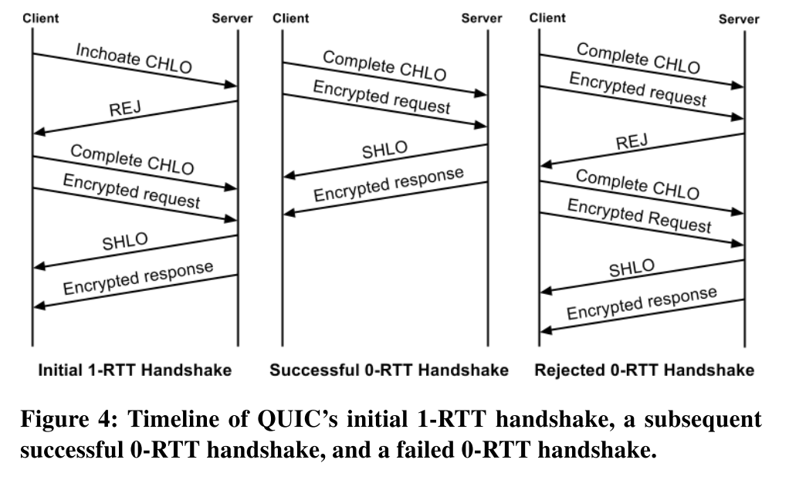
Connection Establishment
Annotations
Client hello (CHLO)
Reject (REJ)
Server hello (SHLO)
An origin is identified by the set of URI scheme, hostname, and port number.
Notes:
Origin 用于区分用户身份

Slide 22
Connection Establishment
REJ Message from Server
Server’s long-term Diffie-Hellman public value
A certificate chain authenticating the server
A signature of the server config using the private key from the leaf certificate of the chain
A source-address token: an authenticated-encryption block that contains the client’s publicly visible IP address (as seen at the server) and a timestamp by the server. The client sends this token back to the server in later handshakes, demonstrating ownership of its IP address.

Slide 23
Connection Establishment
Annotations
Client hello (CHLO)
Reject (REJ)
Server hello (SHLO)
An origin is identified by the set of URI scheme, hostname, and port number.
Notes:
Origin 用于区分用户身份

Slide 24
Connection Establishment
Version Negotiation
A QUIC client proposes a version to use for the connection in the first packet of the connection and encodes the rest of the handshake using the proposed version. If the server does not speak the client-chosen version, it forces version negotiation by sending back a Version Negotiation packet to the client carrying all of the server’s supported versions, causing a round trip of delay before connection establishment.
This mechanism eliminates round-trip latency when the client’s optimistically-chosen version is spoken by the server, and incentivizes servers to not lag behind clients in deployment of newer versions.
To prevent downgrade attacks, the initial version requested by the client and the list of versions supported by the server are both fed into the key-derivation function at both the client and the server while generating the final keys.
Notes:
降级攻击

Slide 25
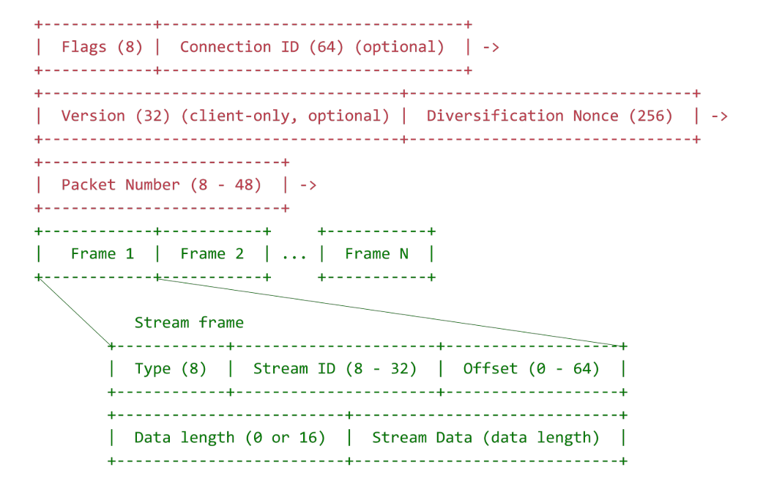
Stream Multiplexing
Applications commonly multiplex units of data within TCP’s single bytestream abstraction.
To avoid head-of-line blocking due to TCP’s sequential delivery, QUIC supports multiple streams within a connection, ensuring that a lost UDP packet only impacts those streams whose data was carried in that packet.
Padding Oracle Attack
Notes:
以包packet为传输单位，UDP packet
一个可选的16位无符号数字指定这个流帧中数据的长度。只有当包是 “全大小(full-sized)” 包时，才应该省略长度，来避免填充破坏的风险。
The parts of the QUIC packet header outside the cover of encryption are required either for routing or for decrypting the packet: Flags, Connection ID, Version Number, Diversification Nonce, and Packet Number.
指出红色部分未加密，绿色加密并分别说明用处

Slide 26
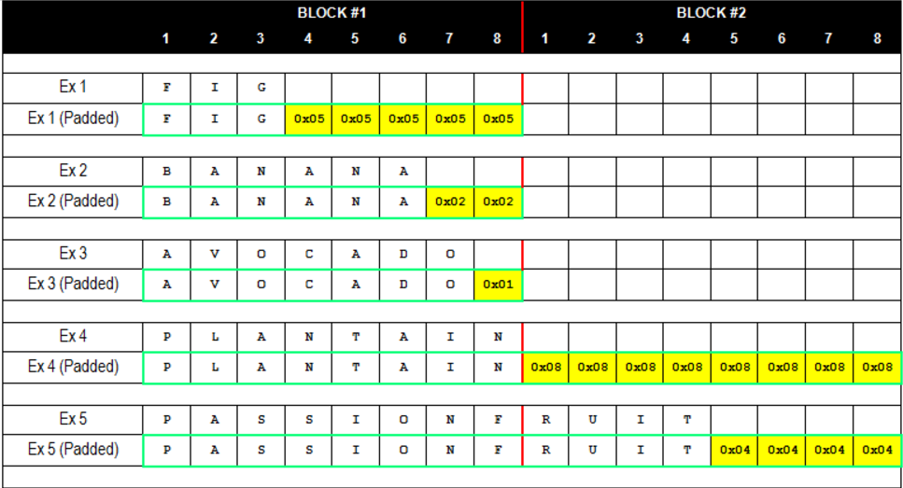
Padding Oracle Attack
Padding oracle 和 CBC 翻转攻击
https://skysec.top/2017/12/13/padding-oracle%E5%92%8Ccbc%E7%BF%BB%E8%BD%AC%E6%94%BB%E5%87%BB/
Notes:
比如我们的明文为admin 则需要被填充为 admin\x0b\x0b\x0b\x0b\x0b\x0b\x0b\x0b\x0b\x0b\x0b 一共11个\x0b 如果我们输入一个错误的iv，依旧是可以解密的，但是middle和我们输入的iv经过异或后得到的填充值可能出现错误 比如本来应该是admin\x0b\x0b\x0b\x0b\x0b\x0b\x0b\x0b\x0b\x0b\x0b 而我们错误的得到admin\x0b\x0b\x0b\x0b\x0b\x0b\x0b\x0b\x0b\x3b\x2c 这样解密程序往往会抛出异常(Padding Error) 应用在web里的时候，往往是302或是500报错 而正常解密的时候是200 所以这时，我们可以根据服务器的反应来判断我们输入的iv
但是关键点在于，我们可以知道iv的值，却不能得到中间值和解密后明文的值 而我们的目标是只根据我们输入的iv值和服务器的状态去判断出解密后明文的值 这里的攻击即叫做Padding Oracle Attack攻击

Slide 27
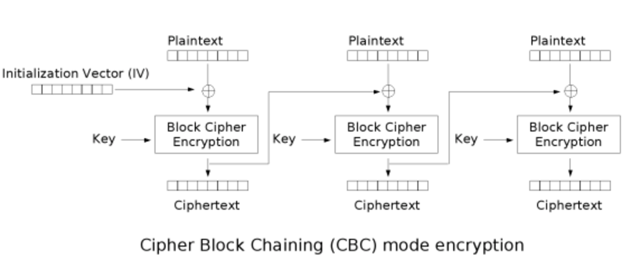
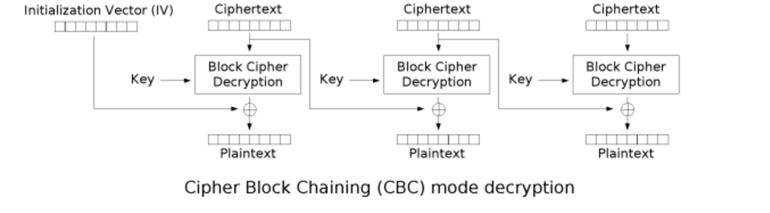
Padding Oracle Attack
Padding oracle 和 CBC 翻转攻击
https://skysec.top/2017/12/13/padding-oracle%E5%92%8Ccbc%E7%BF%BB%E8%BD%AC%E6%94%BB%E5%87%BB/
Notes:
比如我们的明文为admin 则需要被填充为 admin\x0b\x0b\x0b\x0b\x0b\x0b\x0b\x0b\x0b\x0b\x0b 一共11个\x0b 如果我们输入一个错误的iv，依旧是可以解密的，但是middle和我们输入的iv经过异或后得到的填充值可能出现错误 比如本来应该是admin\x0b\x0b\x0b\x0b\x0b\x0b\x0b\x0b\x0b\x0b\x0b 而我们错误的得到admin\x0b\x0b\x0b\x0b\x0b\x0b\x0b\x0b\x0b\x3b\x2c 这样解密程序往往会抛出异常(Padding Error) 应用在web里的时候，往往是302或是500报错 而正常解密的时候是200 所以这时，我们可以根据服务器的反应来判断我们输入的iv
但是关键点在于，我们可以知道iv的值，却不能得到中间值和解密后明文的值 而我们的目标是只根据我们输入的iv值和服务器的状态去判断出解密后明文的值 这里的攻击即叫做Padding Oracle Attack攻击

Slide 28
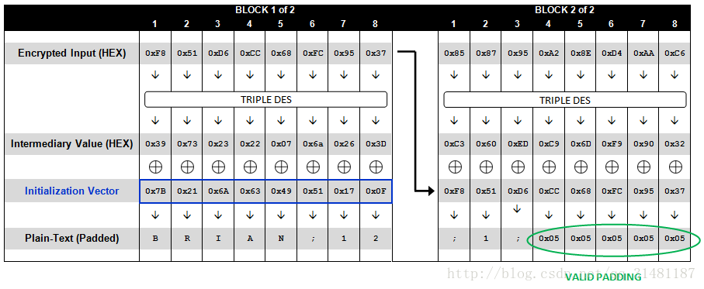
Padding Oracle Attack
Attack Conditions
An attacker can ask the server to decrypt any IV and cipher text.
If the IV is illegal, the server will return specific HTTP status code or other information.
Padding Oracle Attack 分析
https://blog.csdn.net/qq_31481187/article/details/71773789

Slide 29
Padding Oracle Attack
This vulnerability is not a vulnerability in the cryptographic algorithm itself, but it can cause problems when used improperly in production environments.
The key to the reasoning of this binary logic is to find a "distinction point", that is, whether the input that the attacker can use to distinguish this has achieved its purpose (in this case, to find the correct IV).
In the Padding Oracle Attack, the attacker enters the parameter IV + Cipher. We want to request the server to decrypt the Cipher we specified by "exhaustion" of the IV and judge the returned result.
Padding Oracle Attack takes advantage of the principle of reasoning of binary logic, or it is a “side channel attack”.
Notes:
简单带过 侧信道攻击

Slide 30
Stream Multiplexing
Applications commonly multiplex units of data within TCP’s single bytestream abstraction.
To avoid head-of-line blocking due to TCP’s sequential delivery, QUIC supports multiple streams within a connection, ensuring that a lost UDP packet only impacts those streams whose data was carried in that packet.
Padding Oracle Attack
Notes:
在这里再讲一下侧信道攻击的危害

Slide 31
Stream Multiplexing
Packet 1
Success
Stream A Offset 1
Stream B Offset 1
Packet 2
Fail
Stream B Offset 2
Stream C Offset 3
Packet 3
Success
Stream A Offset 2
Time

Slide 32
Stream Multiplexing
Packet 2
Fail
Stream B Offset 2
Stream C Offset 3
Packet 3
Success
Stream A Offset 2
Did not been blocked
Packet 4
Success
Stream A Offset 3
Stream B Offset 2
Retransmit
Retransmit
Stream C Offset 3
Time

Slide 33
Stream Multiplexing
Packet Types and Formats
QUIC has Special Packets and Regular Packets. There are two types of Special Packets: Version Negotiation Packets and Public Reset Packets, and regular packets containing frames.
All QUIC packets should be sized to fit within the path’s MTU to avoid IP fragmentation. The current QUIC implementation uses a 1350-byte maximum QUIC packet size for IPv6, 1370 for IPv4. Both sizes are without IP and UDP overhead.
Frame Types and Formats
QUIC Frame Packets are populated by frames, which have a Frame Type byte, which itself has a type-dependent interpretation, followed by type-dependent frame header fields. All frames are contained within single QUIC Packets and no frame can span across a QUIC Packet boundary.
Notes:
QUIC stream 生命周期
stream 是独立的双向字节流， 可以被客户端和服务端创建，可以并发的和其他stream 收发数据， quic stream 的生命周期和 HTTP/2 模型相似
stream 创建是隐式的，为了避免 stream-ID 碰撞， server 端创建的streamID 是偶数的， client 端的则是基数， 0 是无效的 streamID， streamID 1 被保留用作密钥握手，stream 3 被保留用于发送所有其他流的header。
每一端创建的streamID必须是单调递增的。
一旦一个stream 被创建，这个stream 可以用来收发数据 Frame ，直到该方向的stream被终止
client、server 都可以正常的关闭stream，有以下三种情况一个stream 会被终止
正常终止 因为stream 是双向的，当一方关闭stream 后， stream 就变成了半关闭的，（只能接收不能发送），当另一端也关闭之后， stream 则被认为是关闭了。
突然终止 client 和 server 可以发送 RST_STREAM frame ，这样接收方则认为可以关闭 stream
connection 被终止

Slide 34
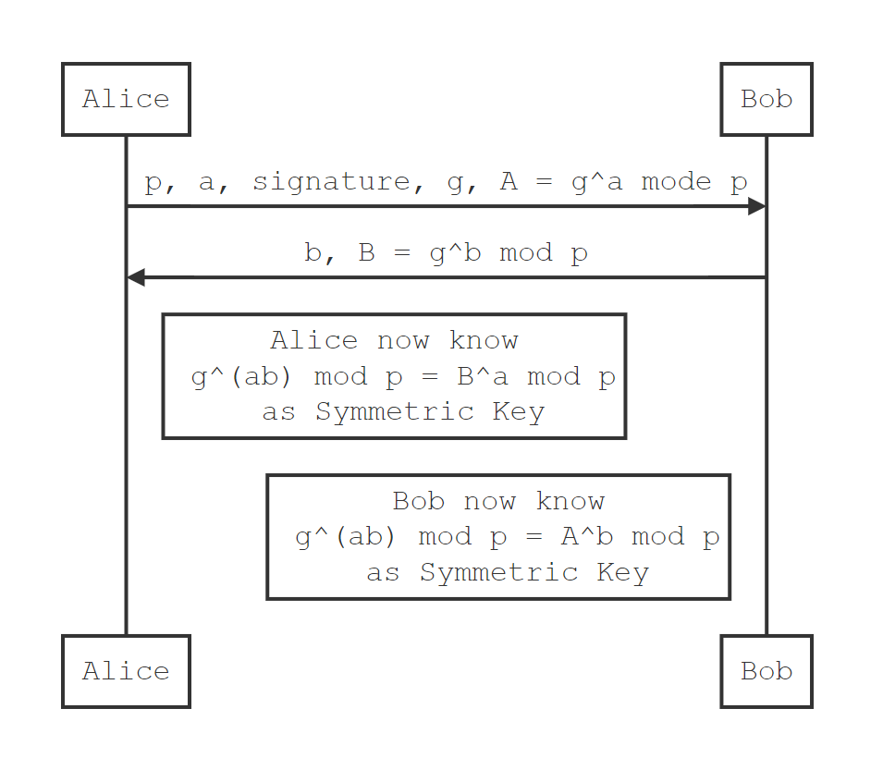
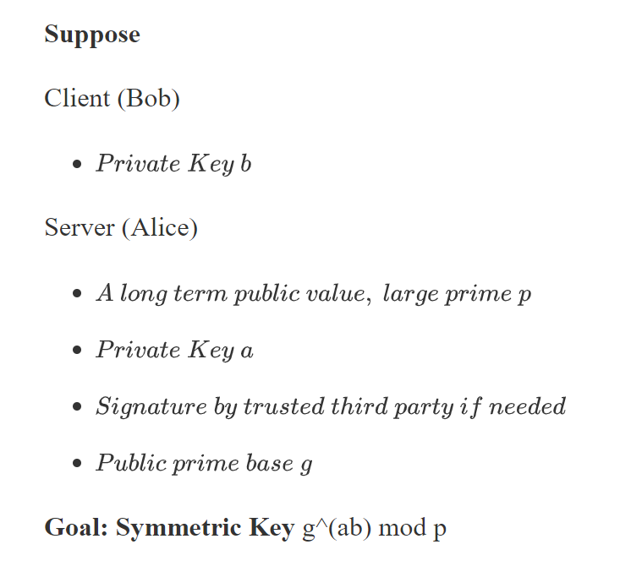
Authentication and Encryption
Cryptography - Diffie-Hellman
Notes:
第三方签名的必要性，中间人攻击

Slide 35
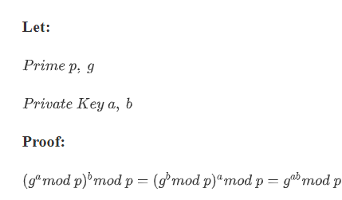
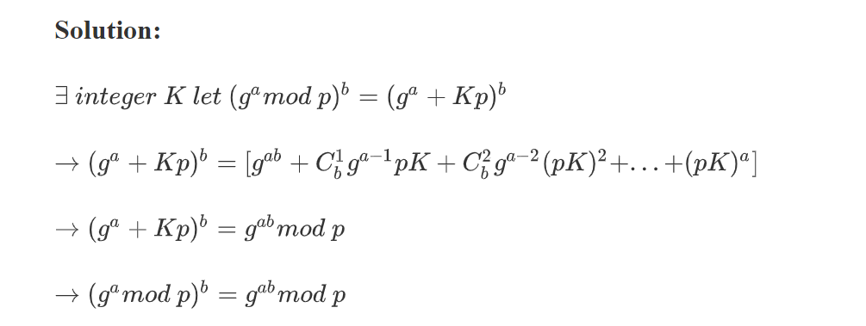
Authentication and Encryption
Proof of Diffie-Hellman

Slide 36
Authentication and Encryption

Slide 37

Authentication and Encryption
With the exception of a few early handshake packets and reset packets, QUIC packets are fully authenticated and mostly encrypted.
Upon sending an SHLO message, the server immediately switches to sending packets encrypted with the forward-secure keys. Upon receiving the SHLO message, the client switches to sending packets encrypted with the forward-secure keys.
Any information sent in unencrypted handshake packets, such as in the Version Negotiation packet, is included in the derivation of the final connection keys.
Notes:
The Connection ID serves routing and identification purposes; it is used by load balancers to direct the connection’s traffic to the right server and by the server to locate connection state.
The version number and diversification nonce fields are only present in early packets.

Slide 38
Authentication and Encryption
Forward Secrecy
In cryptography, forward secrecy (FS), also known as perfect forward secrecy (PFS), is a feature of specific key agreement protocols that gives assurances that session keys will not be compromised even if the private key of the server is compromised.
Forward secrecy protects past sessions against future compromises of secret keys.
Notes:
The Connection ID serves routing and identification purposes; it is used by load balancers to direct the connection’s traffic to the right server and by the server to locate connection state.
The version number and diversification nonce fields are only present in early packets.

Slide 39
Authentication and Encryption
Forward Secrecy
REJ: containing server’s long-term Diffie-Hellman public value
complete CHLO: containing the client’s ephemeral Diffie-Hellman public value.
SHLO: This message is encrypted using the initial keys, and contains the server’s ephemeral Diffie-Hellman public value.
QUIC’s cryptography therefore provides two levels of secrecy
Initial client data (and some early requests) is encrypted using initial keys.
Subsequent client data and all server data are encrypted using forward-secure keys.
Notes:
讲明前向安全性，可以举例说明
说明初期的请求可能只使用 initial key

Slide 40
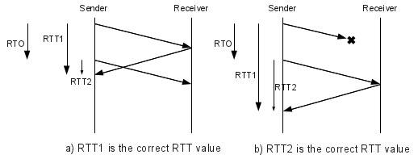
Loss Recovery
Each QUIC packet carries a new packet number, including those carrying retransmitted data.
This design obviates the need for a separate mechanism to distinguish the ACK of a retransmission from that of an original transmission, thus avoiding TCP’s retransmission ambiguity problem. Stream offsets in stream frames are used for delivery ordering, separating the two functions that TCP conflates. The packet number represents an explicit time-ordering, which enables simpler and more accurate loss detection than in TCP.
RTT Sampling Ambiguity
A timeout occurs before an ACK is received, and PKT1 is retransmitted. The ACK for the first PKT1 arrives a bit later and the source measures a wrong value for the RTT.
TCP RTT Estimation, Fast Retransmit, Fast Recovery, Rupesh R. Mehta
https://www.cse.iitb.ac.in/~br/webpage/courses/cs625-fall2003/lec-notes/lec-notes11-1.html
Calculating TCP RTO...
http://sgros.blogspot.com/2012/02/calculating-tcp-rto.html
Notes:
Accurate RTT estimation can also aid delay-sensing congestion controllers such as BBR [10] and PCC [16].

Slide 41
Loss Recovery
Stream offsets in stream frames are used for delivery ordering, separating the two functions that TCP conflates. The packet number represents an explicit time-ordering, which enables simpler and more accurate loss detection than in TCP.
QUIC’s acknowledgments support up to 256 ACK blocks, making QUIC more resilient to reordering and loss than TCP with SACK [46].
Advantages
Accurate RTT estimation can also aid delay-sensing congestion controllers such as BBR [10] and PCC [16].
These differences between QUIC and TCP allowed us to build simpler and more effective mechanisms for QUIC.

Slide 42
Flow Control
Similar to HTTP/2 [8], QUIC employs credit-based flow-control.
A QUIC receiver advertises the absolute byte offset within each stream up to which the receiver is willing to receive data.
As data is sent, received, and delivered on a particular stream, the receiver periodically sends window update frames that increase the advertised offset limit for that stream, allowing the peer to send more data on that stream. Connection-level flow control works in the same way as stream-level flow control, but the bytes delivered and the highest received offset are aggregated across all streams.
Notes:
HTTP/2的流量控制具有以下特征：
流量控制是特定于一个连接的。每种类型的流量控制都是在单独的一跳的两个端点之间的，并不是在整个端到端的路径上的。（这里的一跳指的是HTTP连接的一跳，而不是IP路由的一跳）
流量控制是基于WINDOW_UPDATE帧的。接收方公布自己打算在每个流以及整个连接上分别接收多少字节。这是一个以信用为基础的方案。
流量控制是有方向的，由接收者全面控制。接收方可以为每个流和整个连接设置任意的窗口大小。发送方必须尊重接收方设置的流量控制限制。客户方、服务端和中间代理作为接收方时都独立地公布各自的流量控制窗口，作为发送方时都遵守对端的流量控制设置。
无论是新流还是整个连接，流量控制窗口的初始值是65535字节。
帧的类型决定了流量控制是否适用于帧。目前，只有DATA帧服从流量控制，所有其它类型的帧并不消耗流量控制窗口的空间。这保证了重要的控制帧不会被流量控制阻塞。
流量控制不能被禁用。
HTTP/2只定义了WINDOW_UPDATE帧的格式和语义，并没有规定接收方如何决定何时发送帧、发送什么样的值，也没有规定发送方如何选择发送包。具体实现可以选择任何满足需求的算法。
WINDOW_UPDATE是HTTP/2定义的帧类型的一种，用途是通知对端增加窗口值，WINDOW_UPDATE会指定增加的大小发送端保有一个流量控制窗口（window）初始值。初始值的设定请参考SETTING 帧的 SETTINGS_INITIAL_WINDOW_SIZE
发送端每发送一个DATA帧，就把window递减，递减量为这个帧的大小。如果当前window小于帧大小，那么这个帧就必须被拆分到不大于window，如果window等于0，就不能发送任何帧
接收端可以发送 WINDOW_UPDATE帧给发送端，发送端以帧内指定的Window Size Increment作为增量，加到window上

Slide 43

Congestion Control
The QUIC protocol does not rely on a specific congestion control algorithm and our implementation has a pluggable interface to allow experimentation.
Pluginizing QUIC
Notes:
Pluginizing QUIC 可以将 Congestion Control 以插件形式提供

Slide 44
NAT Rebinding and Connection Migration
QUIC connections are identified by a 64-bit Connection ID.
QUIC’s Connection ID enables connections to survive changes to the client’s IP and port. Such changes can be caused by NAT timeout and rebinding (which tend to be more aggressive for UDP than for TCP [27]) or by the client changing network connectivity to a new IP address.
While QUIC endpoints simply elide the problem of NAT rebinding by using the Connection ID to identify connections, client-initiated connection migration is a work in progress with limited deployment at this(that) point.

Slide 45
QUIC Discovery for HTTPS
A client does not know a priori whether a given server speaks QUIC. When our client makes an HTTP request to an origin for the first time, it sends the request over TLS/TCP. Our servers advertise QUIC support by including an "Alt-Svc" header in their HTTP responses [48]. This header tells a client that connections to the origin may be attempted using QUIC. The client can now attempt to use QUIC in subsequent requests to the same origin.
On a subsequent HTTP request to the same origin, the client races a QUIC and a TLS/TCP connection, but prefers the QUIC connection by delaying connecting via TLS/TCP by up to 300 ms. Whichever protocol successfully establishes a connection first ends up getting used for that request. If QUIC is blocked on the path, or if the QUIC handshake packet is larger than the path’s MTU, then the QUIC handshake fails, and the client uses the fallback TLS/TCP connection.
Nginx(or other HTTP server)
Listening TCP 443
Client
Caddy(or other server support QUIC)
Listening UDP 443

Slide 46
Open-Source Implementation
Our implementation of QUIC is available as part of the open-source Chromium project [1]. This implementation is shared code, used by Chrome and other clients such as YouTube, and also by Google servers albeit with additional Google-internal hooks and protections. The source code is in C++, and includes substantial unit and end-to-end testing. The implementation includes a test server and a test client which can be used for experimentation, but are not tuned for production-level performance.

Slide 47
EXPERIMENTS & EXPERIENCES
4

Slide 48
EXPERIMENTS & EXPERIENCES
Experiments
Experimentation Framework
QUIC Performance
Performance By Region
Server CPU Utilization
Performance Limitations
Experiences
Packet Size Considerations
UDP Blockage and Throttling
Forward Error Correction
User-space Development
Experiences with Middleboxes

Slide 49
Experimentation Framework
Our development of the QUIC protocol relies heavily on continual Internet-scale experimentation to examine the value of various features and to tune parameters. In this section we describe the experimentation frameworks in Chrome and our server fleet, which allow us to experiment safely with QUIC.
We drove QUIC experimentation by implementing it in Chrome, which has a strong experimentation and analysis framework that allows new features to be A/B tested and evaluated before full launch. Chrome’s experimentation framework pseudo-randomly assigns clients to experiments and exports a wide range of metrics, from HTTP error rates to transport handshake latency. Clients that are opted into statistics gathering report their statistics along with a list of their assigned experiments, which subsequently enables us to slice metrics by experiment. This framework also allows us to rapidly disable any experiment, thus protecting users from problematic experiments.

Slide 50
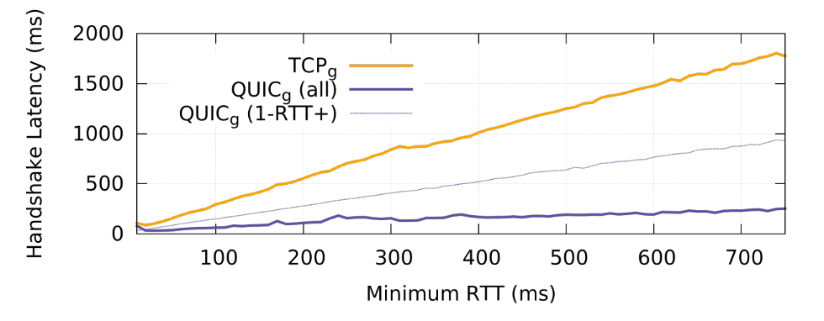
QUIC Performance
Handshake Latency is the amount of time taken to establish a secure transport connection. In TLS/TCP, this includes the time for both the TCP and TLS handshakes to complete. We measured handshake latency at the server as the time from receiving the first TCP SYN or QUIC client hello packet to the point at which the handshake is considered complete. In the case of a QUIC 0-RTT handshake, latency is measured as 0 ms. Figure shows the impact of QUIC’s 0-RTT and 1-RTT handshakes on handshake latency.
Notes:
握手延迟，实际1.5RTT左右

Slide 51
QUIC Performance
Search Latency is the delay between when a user enters a search term and when all the search-result content is generated and delivered to the client by Google Search, including all corresponding images and embedded content. On average, an individual search performed by a user results in a total response load of 100 KB for desktop searches and 40 KB for mobile searches. As a metric, Search Latency represents delivery latency for small, delay-sensitive, dynamically-generated payloads.
Video Latency for a video playback is measured as the time between when a user hits "play" on a video to when the video starts playing. To ensure smooth playbacks, video players typically buffer a couple seconds of video before playing the first frame. The amount of data the player loads depends on the bitrate of the playback.
Video Rebuffer Rate, or simply Rebuffer Rate is the percentage of time that a video pauses during a playback to rebuffer data normalized by video watch time, where video watch time includes time spent rebuffering. In other words, Rebuffer Rate is computed as (Rebuffer Time) / (Rebuffer Time + Video Play Time).
Notes:
讲解三个Latency的试验标准

Slide 52
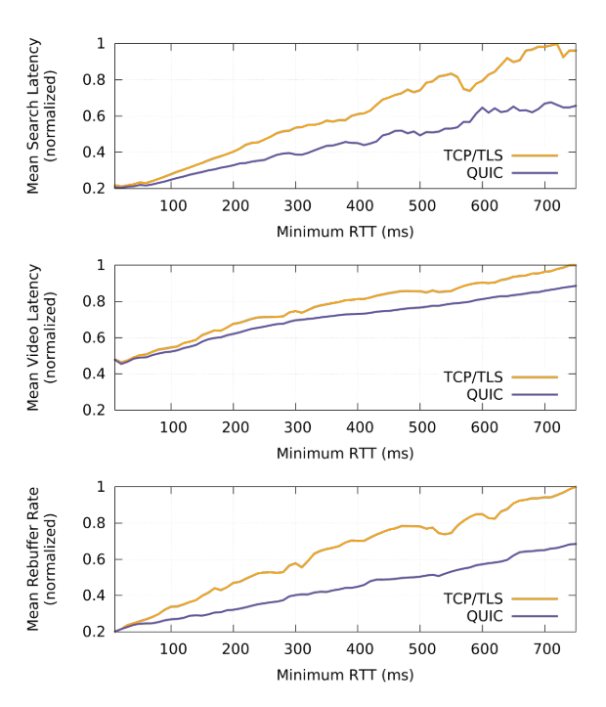
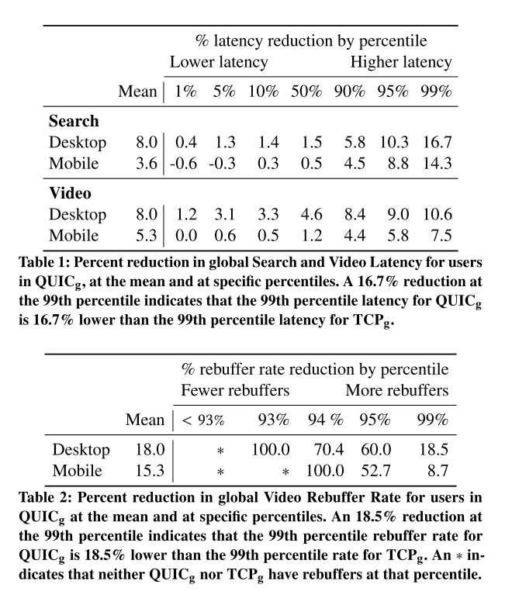
QUIC Performance
Notes:
Video YouTube pre connect

Slide 53
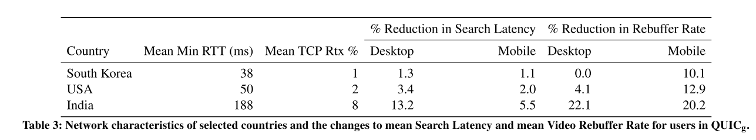
Performance By Region
Differences in access-network quality and distance from Google servers result in RTT and retransmission rate variations for different geographical regions. We now look at QUIC’s impact on Search Latency and on Video Rebuffer Rate in select countries, chosen to span a wide range of network conditions.
Table 3 show how QUIC’s performance impact varies by country.
In South Korea, which has the lowest average RTT and the lowest network loss, QUIC’s performance is closer to that of TCP. Network conditions in the United States are more typical of the global average, and QUIC shows greater improvements in the USA than in South Korea. India, which has the highest average RTT and retransmission rate, shows the highest benefits across the board. QUIC’s performance benefits over TLS/TCP are thus not uniformly distributed across geography or network quality: benefits are greater in networks and regions that have higher average RTT and higher network loss.
Notes:
高速网下表现较差

Slide 54
Server CPU Utilization
The QUIC implementation was initially written with a focus on rapid feature development and ease of debugging, not CPU efficiency. When we started measuring the cost of serving YouTube traffic over QUIC, we found that QUIC’s server CPU-utilization was about 3.5 times higher than TLS/TCP.
The three major sources of QUIC’s CPU cost were: cryptography, sending and receiving of UDP packets, and maintaining internal QUIC state.
To reduce cryptographic costs, we employed a hand-optimized version of the ChaCha20 cipher favored by mobile clients.
To reduce packet receive costs, we used asynchronous packet reception from the kernel via a memory-mapped application ring buffer (Linux’s PACKET_RX_RING).
Finally, to reduce the cost of maintaining state, we rewrote critical paths and data-structures to be more cache-efficient.
With these optimizations, we decreased the CPU cost of serving web traffic over QUIC to approximately twice that of TLS/TCP, which has allowed us to increase the levels of QUIC traffic we serve.
Notes:
ChaCha20-Poly1305是Google所采用的一种新式加密算法，性能强大，在CPU为精简指令集的ARM平台上尤为显著（ARM v8前效果较明显），在同等配置的手机中表现是AES的4倍（ARM v8之后加入了AES指令，所以在这些平台上的设备，AES方式反而比chacha20-Poly1305方式更快，性能更好），可减少加密解密所产生的数据量进而可以改善用户体验，减少等待时间，节省电池寿命等。
ChaCha系列流密码，作为salsa密码的改良版，具有更强的抵抗密码分析攻击的特性，“20”表示该算法有20轮的加密计算。
由于是流密码，故以字节为单位进行加密，安全性的关键体现在密钥流生成的过程，即所依赖的伪随机数生成器（PRNG）的强度，加密过程即是将密钥流与明文逐字节异或得到密文，反之，解密是将密文再与密钥流做一次异或运算得到明文。
User space development
PACKET_MMAP的实现原理
PACKET_MMAP在内核空间中分配一块内核缓冲区，然后用户空间程序调用mmap映射到用户空间。将接收到的socket buffer拷贝到那块内核缓冲区中，这样用户空间的程序就可以直接读到捕获的数据包了。
如果没有开启PACKET_MMAP，只是依靠AF_PACKET非常的低效。它有缓冲区的限制，并且每捕获一个报文就需要一个系统调用，如果为了获得packet的时间戳就需要两个系统调用了（获得时间戳还需要一个系统调用，libpcap就是这样做的）。
PACKET_MMAP非常高效，它提供一个映射到用户空间的大小可配置的环形缓冲区。这种方式，读取报文只需要等待报文就可以了，大部分情况下不需要系统调用（其实poll也是一次系统调用）。通过内核空间和用户空间共享的缓冲区还可以起到减少数据拷贝的作用。
当然为了提高捕获的性能，不仅仅只是PACKET_MMAP。如果你在捕获一个高速网络中的数据，你应该检查NIC是否支持一些中断负载缓和机制或者是NAPI，确定开启这些措施。
PACKET_MMAP减少了系统调用，不用recvmsg就可以读取到捕获的报文，相比原始套接字+recvfrom的方式，减少了一次拷贝和一次系统调用。
https://blog.csdn.net/lizhitao/article/details/9358579

Slide 55
Performance Limitations
Pre-warmed connections: When applications hide handshake latency by performing handshakes proactively, these applications receive no measurable benefit from QUIC’s 0-RTT handshake.
High bandwidth, low-delay, low-loss networks: The use of QUIC on networks with plentiful bandwidth, low delay, and low loss rate, shows little gain and occasionally negative performance impact. When used over a very high-bandwidth (over 100 Mbps) and/or very low RTT connection (a few milliseconds), QUIC may perform worse than TCP.
Mobile devices: QUIC’s gains for mobile users are generally more modest than gains for desktop users.
Notes:
This optimization is not uncommon in applications where the server is known a priori, and is used by the YouTube app. We note that some applications, such as web browsers, cannot always pre-warm connections since the server is often unknown until explicitly indicated by the user.
We believe that this limitation is due to client CPU limits and/or client-side scheduler inefficiencies in the OS or application. While these ranges are outside typical Internet conditions, we are actively looking into mitigations in these cases.
As discussed earlier in this section, this is partially due to the fact that mobile applications are often fine-tuned for their environment. For example, when applica- tions limit content for small mobile-screens, transport optimizations have less impact. Mobile phones are also more CPU-constrained than desktop devices, causing CPU to be the bottleneck when net- work bandwidth is plentiful. We are actively working on improving QUIC’s performance on mobile devices.

Slide 56
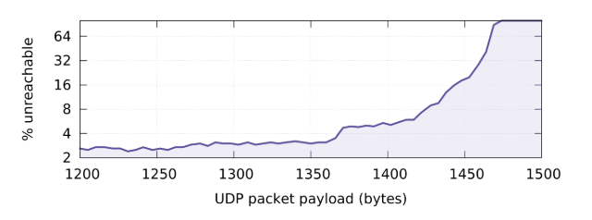
Packet Size Considerations
We tested a range of possible UDP payload sizes, from 1200 bytes up to 1500 bytes, in 5 byte increments. For each packet size, approximately 25,000 instances of Chrome would attempt to send UDP packets of that size to an echo server on our network and wait for a response. If at least one response was received, this trial counted as a reachability success, otherwise it was considered to be a failure.
Notes:
—exceeding the 1500 byte Ethernet MTU. Based on this data, we chose 1350 bytes as the default payload size for QUIC. Future

Slide 57
UDP Blockage and Throttling
QUIC is successfully used for 95.3% of video clients attempting to use QUIC. 4.4% of clients are unable to use QUIC, meaning that QUIC or UDP is blocked or the path’s MTU is too small. Manual inspection showed that these users are commonly found in corporate networks, and are likely behind enterprise firewalls. We have not seen an entire ISP blocking QUIC or UDP.
The remaining 0.3% of users are in networks that seem to rate limit QUIC and/or UDP traffic. We detect rate limiting as substantially elevated packet loss rate and decreased bandwidth at peak times of day, when traffic is high.
Notes:
得出这个结论没有考虑中国情况

Slide 58
Forward Error Correction
We experimented with various packet protection policies—protecting only HTTP headers, protecting all data, sending an FEC packet only on quiescence—and found similar outcomes. While retransmission rates decreased measurably, FEC had statistically insignificant impact on Search Latency and increased both Video Latency and Video Rebuffer Rate for video playbacks.
In addition to benefits that were not compelling, implementing FEC introduced a fair amount of code complexity. Consequently, we removed support for XOR-based FEC from QUIC in early 2016.
Notes:
前向錯誤更正（英語：forward error correction，縮寫FEC）或通道編碼（英語：channel coding）^{[1]}是一種在單向通訊系統中控制傳輸錯誤的技術，通過連同資料發送額外的資訊進行錯誤恢復，以降低位元錯誤率。FEC又分為帶內FEC和帶外FEC。FEC的處理往往發生在早期階段處理後的數字訊號是第一次收到。也就是說，糾錯電路往往是不可分割的一部分的類比到數字的轉換過程中，還涉及數字調製解調，或線路編碼和解碼。
FEC是通過添加冗餘資訊的傳輸採用預先確定的演算法。1949年漢明（Hamming）提出了可糾正單個隨機差錯的漢明碼。1960年Hoopueghem、Bose和Chaudhum發明了BCH碼，Reed與Solomon又提出ReedSolomon（RS）編碼，糾錯能力很強，後來稱之為里德-所羅門誤碼校正編碼（The reed-solomon error correction code，即後來的附加的前向錯誤更正）。ITU-T G.975/G.709規定了「帶外FEC」是在SDH層下面增加一FEC層，專門處理FEC的問題。帶外FEC編碼冗餘度大，糾錯能力較強。FEC有別於ARQ，發現錯誤無須通知傳送方重發。一旦系統遺失了原始的資料封包，FEC機制可以以冗餘封包加以補入。例如有一資料封包為「10」，分成二個封包，分別為「1」和「0」，有一冗餘封包「0」，收到任意兩個封包就能組裝出原始的包。但這些冗餘封包也會產生額外負擔。

Slide 59
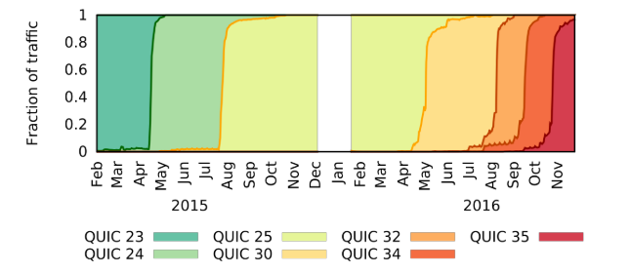
User-space Development
Development practices directly influence robustness of deployed code. In keeping with modern software development practices, we relied heavily on extensive unit and end-to-end testing. We used a network simulator built into the QUIC code to perform fine-grained congestion control testing. Such facilities, which are often limited in kernel development environments, frequently caught significant bugs prior to deployment and live experimentation.
An added benefit of user-space development is that a user-space application is not as memory-constrained as the kernel, is not limited by the kernel API, and can freely interact with other systems in the server infrastructure. This allows for extensive logging and integration with a rich server logging infrastructure, which is invaluable for debugging.
Notes:
讲述模拟环境与实验环境的区别
发现bug，马上结束测试得益于User space development
Linux user space
I/O, call kernel space’s driver
我们发送匿名数据也在协助实验

Slide 60
Experiences with Middleboxes
In October 2016, we introduced a 1-bit change to the public flags field of the QUIC packet header. This change resulted in pathological packet loss for users behind one brand of firewall that supported explicit blocking of QUIC traffic. In previous versions of QUIC, this firewall correctly blocked all QUIC packets, causing clients to fall back to TCP. The firewall used the QUIC flags field to identify QUIC packets, and the 1-bit change in the flags field confounded this detection logic, causing the firewall to allow initial packets through but blocking subsequent packets. As a result, clients that were previously using TCP (since QUIC was previously successfully blocked) were now starting to use QUIC and then hitting a packet black-hole. The problem was fixed by reverting the flags change across our clients.
Notes:
Middleboxes 指的是中间的虚拟化的网络设备

Slide 61
Experiences with Middleboxes
While we were able to isolate the problem to one vendor in this instance, our process of reaching out to them does not scale to all middleboxes and vendors. We do not know if other bits exposed by QUIC have been ossified by this or other middleboxes, and we do not have a method to answer this question at Internet scale. We did learn that middlebox vendors are reactive. When traffic patterns change, they build responses to these observed changes. This pattern of behavior exposes a "deployment impossibility cycle" however, since deploying a protocol change widely requires it to work through a huge range of middleboxes, but middleboxes only change behavior in response to wide deployment of the change. This experience reinforces the premise on which QUIC was designed: when deploying end-to-end changes, encryption is the only means available to ensure that bits that ought not be used by a middlebox are in fact not used by one.
Notes:
这段不太明白

Slide 62
推荐阅读
QUIC: A UDP-Based Multiplexed and Secure Transport (draft-ietf-quic-transport-24)
https://datatracker.ietf.org/doc/draft-ietf-quic-transport/
QUIC at 10,000 feet
https://docs.google.com/document/d/1gY9-YNDNAB1eip-RTPbqphgySwSNSDHLq9D5Bty4FSU/
QUIC, a multiplexed stream transport over UDP
https://www.chromium.org/quic
QUIC Wire Layout Specification
https://docs.google.com/document/d/1WJvyZflAO2pq77yOLbp9NsGjC1CHetAXV8I0fQe-B_U/
本站开始支持 QUIC
https://halfrost.com/quic_start/
QUIC在⼿机微博中的应⽤实践
https://pic.huodongjia.com/ganhuodocs/2018-04-28/1524906080.9.pdf
初探 quic 协议篇
http://ralphbupt.github.io/2018/04/08/%E5%88%9D%E6%8E%A2-quic-%E5%8D%8F%E8%AE%AE%E7%AF%87/
科普：QUIC协议原理分析
https://zhuanlan.zhihu.com/p/32553477

Slide 63
THANKS

